Slide 1

Loan Defaulter System
GROUP MEMBERS:-
Antik Ganguly,Future Institute of Engineering & Management,161480110207
Sayan Dey, Future Institute of Engineering & Management,161480110280
Arijit Guin, Future Institute of Engineering & Management,
Kunal Shaw,RCC Institute of Information Technology,161170110038
Anurag Dutta, RCC Institute of Information Technology,161170110378
Akash Naskar, RCC Institute of Information Technology,161170110198
Sayan Banerjee,Institute of Engineering and Management,

Slide 2

Table Of Contents
Acknowledgement
• Project Objective
• Project Scope
• Requirement Specification
• Database Description
Exploratory Data Analysis
Missing value treatment
Treatment of categorical values
Treatment of skewed values
Feature selection
• Model Building
• Future Scope of Improvements

Slide 3
PROJECT OBJECTIVE
In this project,we try to build a predictive model that will predict the default loan credit of a candidate. The dataset we have used creates a supervised machine learning model based on classification algorithms.Since the ouput feature in our dataset has only two sets of values, we can call this a binary classification problem,where the model will predict whether a client will return the loan he/she has taken or not.
To train the model,we need to clean the data through Exploratory Data
Analysis,to achieve the best accuracy of the model.In this project,we implement various classification algorithms like Logistics Regression,Decision Tree,etc. and based on thier accuracy score we select
the best classifier to train the model.
The datset that we have used to train the model is collected from
Kaggle.com.

Slide 4

Project Scope
Our project is basically a loan defaulter system that can
be used in banking or financial sectors,to determine the
probabilities of getting back the amount they are granting
as loan,to their customers .The model we have
built,predicts the chances of a client returning loan he is
taking from the bank,on the basis of the categorical and
continuous features present in our dataset.Thus on
analysing the features of a new loan creditor,the bank is
able to make a rough estimation whether or not he/she
will return the loan and the bank's bussiness goes on
smooth.

Slide 5

Hardware & Software Requirements
HARDWARE REQUIREMENTS:-
· Processor- i3(6th gen)
· Ram- 2GB
SOFTWARE REQUIREMENTS:-
· Anaconda version 3.7
· Windows7 and above operating system
· MS-OFFICE

Slide 6


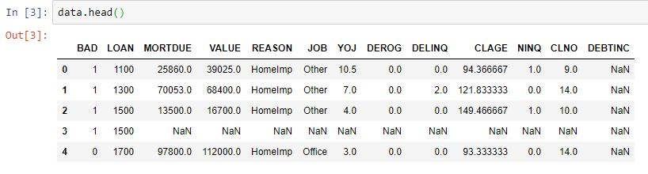
Data Description
Shape of the Data:-
Our dataset has 13 features and 5960 columns
First five rows of the dataset:-

Slide 7

Feature Description
“BAD”(Output Feature) : 1 = client defaulted on loan, 0 = loan repaid (Boolean)
“LOAN” : Amount of the loan request (Number)
“MORTDUE” : Amount due on existing mortgage (Number)
“VALUE”: Value of current property (Number)
“REASON”: “DebtCon” = debt consolidation “HomeImp” = home improvement (Categorical)
“JOB” : Six occupational categories (Categorical)
“YOJ” : Years at present job (Number)
“DEROG” : Number of major derogatory reports (Number)
“DELINQ” : Number of delinquent credit lines (Number)
“CLAGE” : Age of oldest trade line in months (Number)
“NINQ” : Number of recent credit lines (Number)
“CLNO” : Number of credit lines (Number)
“DEBTINC” : Debt-to-income ratio (Number)

Slide 8

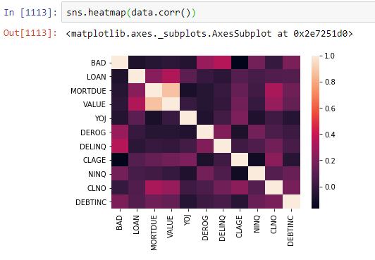
EXPLORATORY DATA ANALYSIS
Exploratory data analysis (EDA) is an approach to analyzing data sets to summarize their main characteristics, often with visual methods. A statistical model can be used or not, but primarily EDA is for seeing what the data can tell us beyond the formal modeling or hypothesis testing task.
Correlation Heat Map

Slide 9

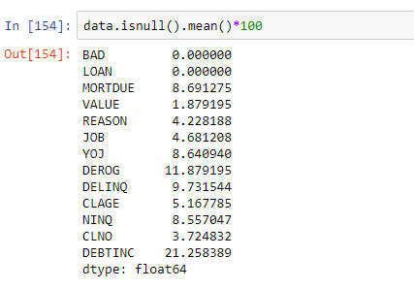
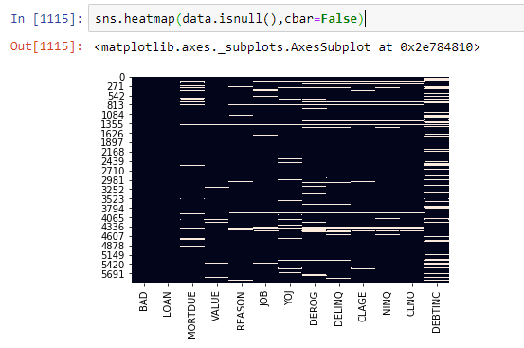
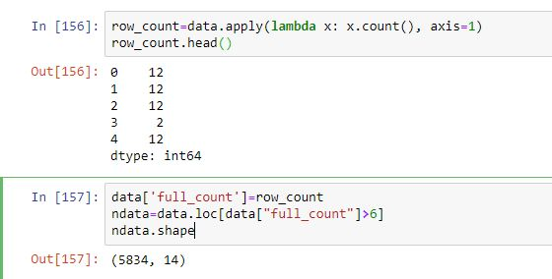
MISSING VALUE TREATMENT
Percentage of missing values:-
Heatmap for missing values
In this heatmap we can see that there are certain rows in which more than half of the features contain missing values. We will drop those rows.
To drop those rows we have calculated the the number of not null values in each row. Only those rows which have more than 50% missing values are kept in the dataset.

Slide 10
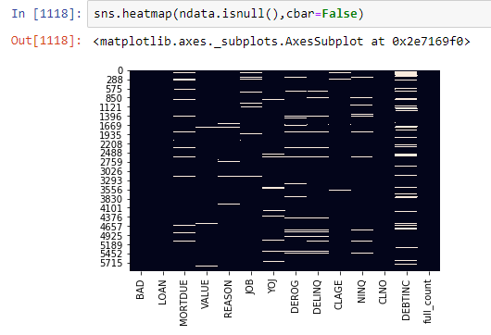
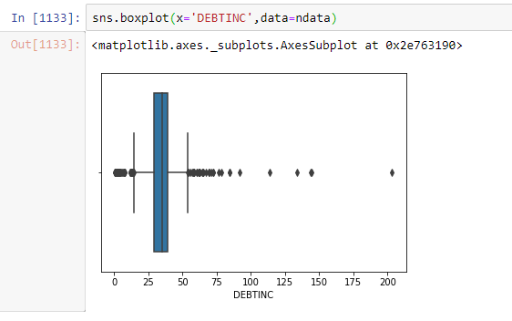
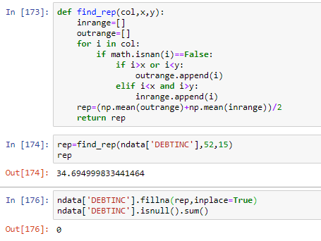
HeatMap after dropping the rows:-
The dataset still has missing values which we can fill by median or mean based on the presence of outliers.
For visualizing outliers in a particular feature we use boxplot from seaborn. Boxplot of feature ‘DEBTINC’:
←To find a value that can we fill in place of the missing values, we have created a function that will find the replacement using the mean of outliers and the mean of inliers.
←This way we have replaced null values of all the continuous features of the dataset

Slide 11

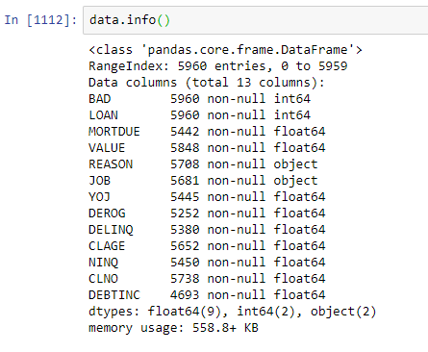
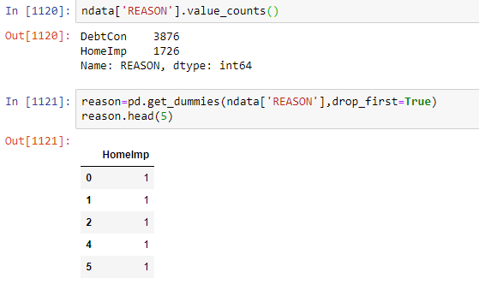
TREATMENT OF CATEGORICAL VALUES
A machine learning model can work on only numeric data. So, we have to convert the categorical features into numeric forms.
Data information:
There are two features with categorical values : “REASON” and “JOB”.
To convert them into numeric types we have used theget_dummies function in pandas. For example, in the feature ‘Reason’ we can create dummy dataframe like this-

Slide 12
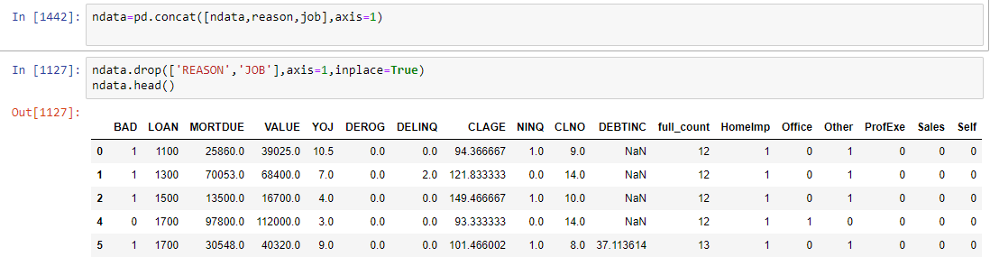
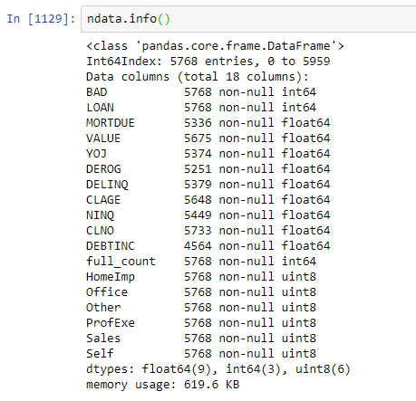
We did the same for other categorical features and then we have concatenated the dummy features with the actual dataset and have dropped the original features.
After treating categorical values:-

Slide 13
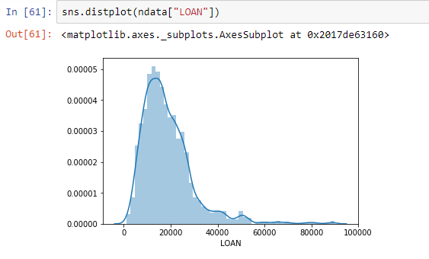
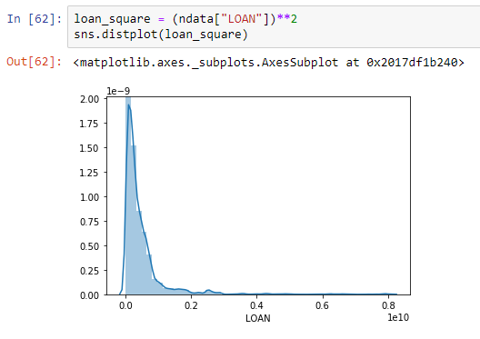
TREATMENT OF SKEWED FEATURES
We need to normalize the data as much as possible before giving it to our model. To do that we need to check the distribution of each feature and find out whether the graph is left skewed or right skewed. If the graph is left skewed, we can try to fix it by using squares and cubes. If the graph is right skewed, we can try to fix it by using squareroots, cuberoots, reciprocals or logarithms. For example, the distplot of the feature “LOAN” is
After finding the square, the graph looks like
This feature is left skewed since the peak is shifted towards left.
After finding the square, the graph looks like:-

Slide 14

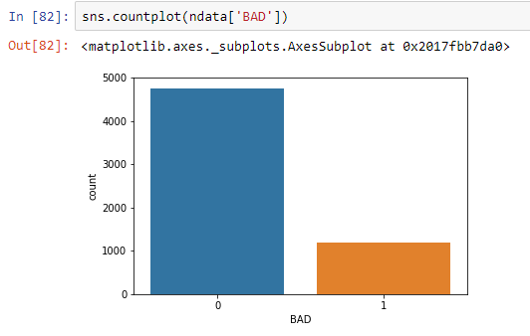
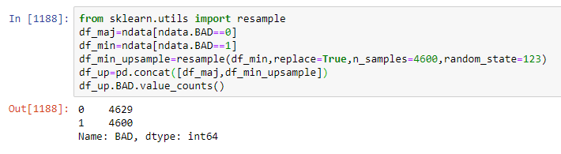
TREATMENT OF CLASS IMBALANCE
Class imbalance is a problem in machine learning where the total number of one class of data (positive) is far less or far more than the total number of another class of data (negative) in the output feature. If we don’t treat this, there might be a biasness in the model towards the class occurring more.
Countplot of the feature “BAD” :
There is a clear class imbalance in this feature where the number of 0s is far more than the number of 1s.
To solve this problem we can either increase the number of minority instances or decrease number of the majority instances with the help of resample method in sklearn.
Here we have upsampled the instances with 1s in the output feature.

Slide 15
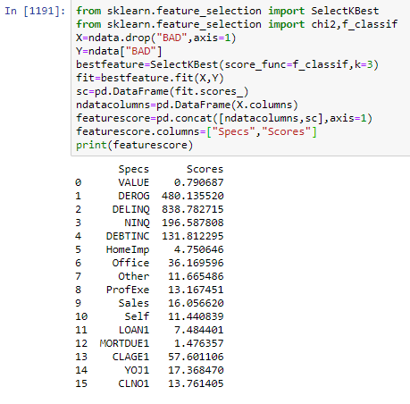
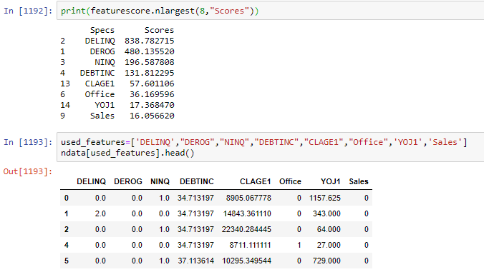
Feature Selection
We have selected the features that should be used for training the model with the help of their correlation and score with respect to the output feature.
To train the model we have selected 8 features with highest score:-

